Slide 1




Risk Management of Future Large-scale Electrification
Mladen Kezunovic, USA
5th SEERC Conference Sarajevo – June 4-5, 2025

Slide 2
Table of contents
Goal: Reduce CO2 through massive electrification
Objective: Identify, manage and reduce impact of the forced outage SoR
Approach: Model the state of risk (SoR)
Action: Manage and mitigate the SoR
Metrics: Differentiate the SoR vs resilience
Examples: T&D and grid at the edge

Slide 3
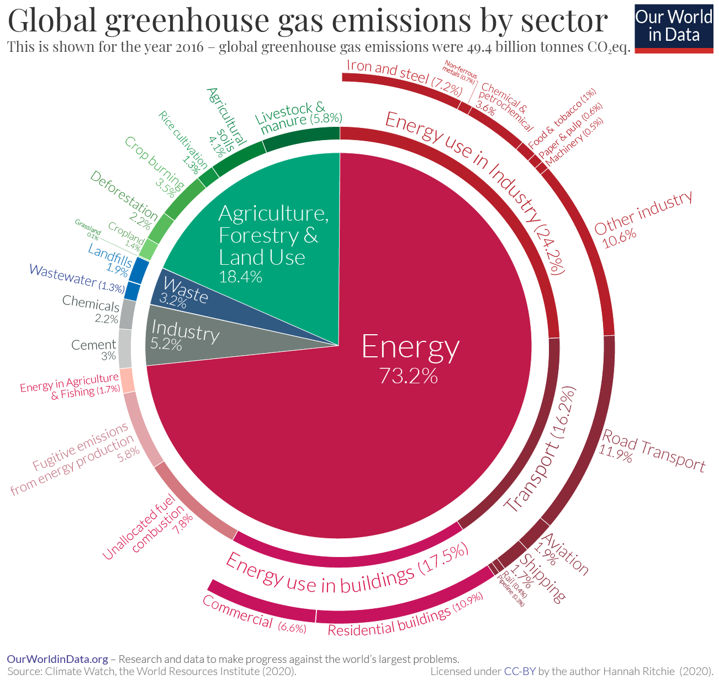
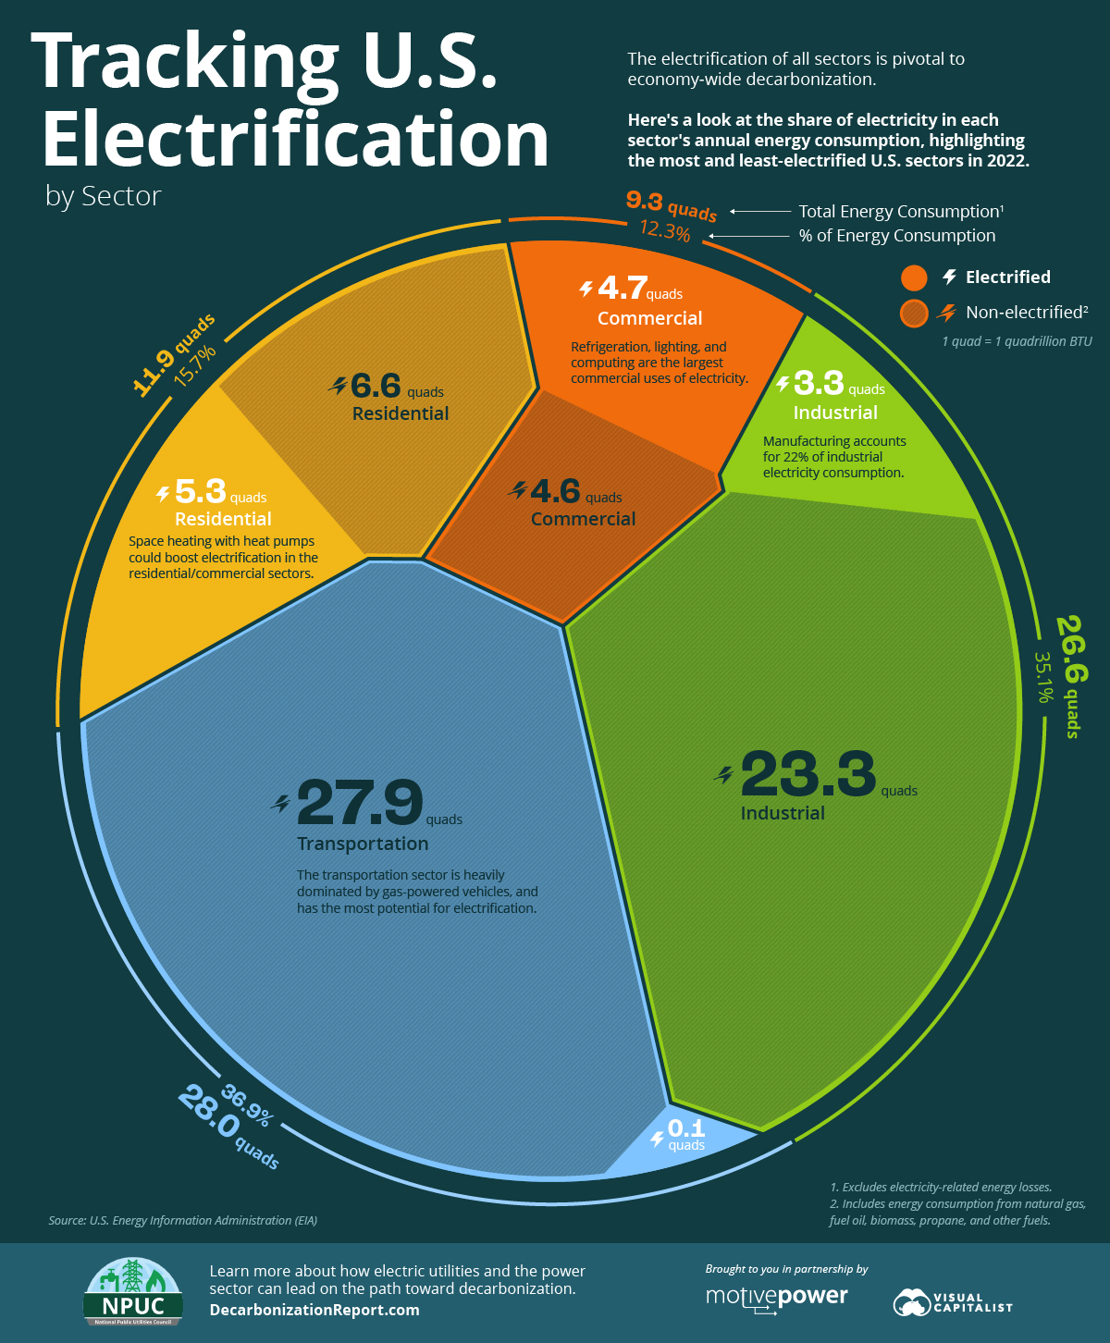
Goal: Reduce CO2 through massive electrification

Slide 4

Goal: Reduce CO2 through massive electrification
Infrastructure interdependencies
We live in an environment of tightly coupled critical infrastructures
Failures in the electric system create risk across many critical infrastructures
Understanding the risk of electric grid failures resulting in forced outages is of paramount importance

Slide 5
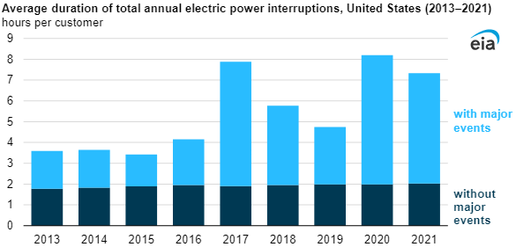
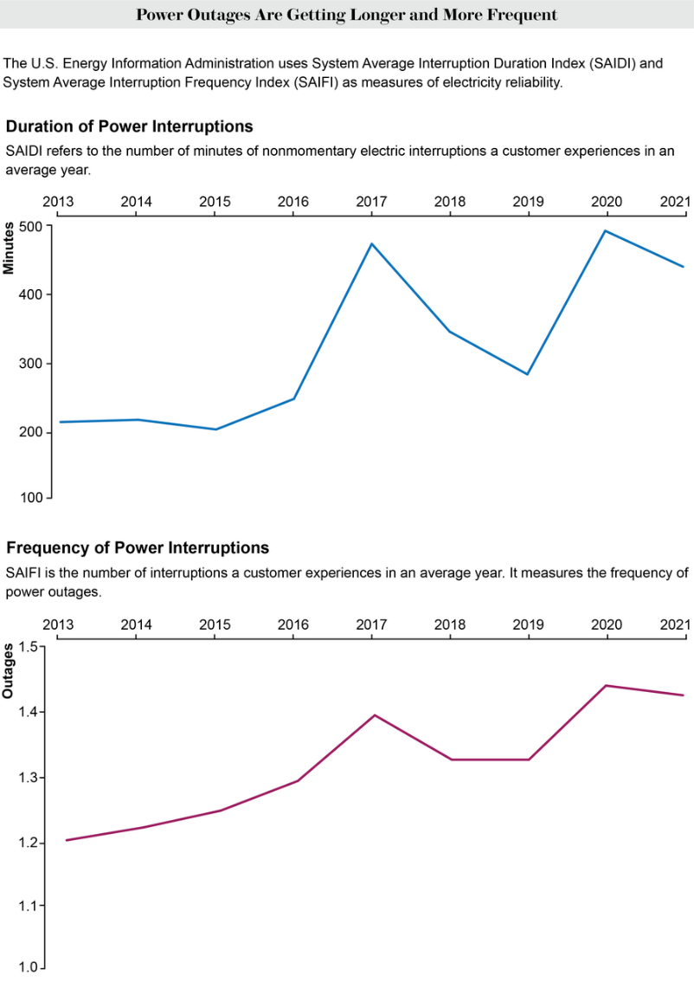
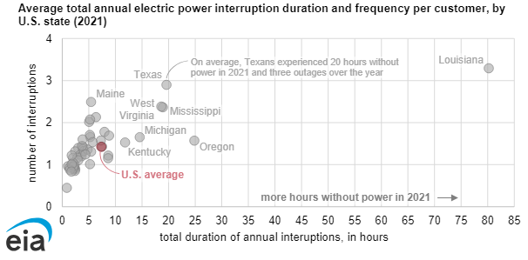
Goal: Reduce CO2 through massive electrification
What is the forced outage frequency and duration?

Slide 6
Objective: Identify, manage and reduce impact of the forced outage SoR
Origin | Causes
Inclement weather (long and short term) | (Uneven) legacy infrastructure wear and tear, and faults
AC/DC controller interactions | (Unclear) Grid fault impact on inverter control and protective relaying
Cyber-physical security, privacy, trustworthiness | (Unquantified) System failures and integrity breaches
Decision-making complexity | (Inadequate) electrical grid dynamic support and control systems
Behavioral economics in the grid edge markets | (Insufficient) regulatory and legislative incentives framework

Slide 7
Objective: Identify, manage and reduce impact of the forced outage SoR
Precursors to managing the SoR
Regulatory action
Offer market incentives for energy exchange (cooperative consumer engagement through flexible load/prosumer)
Capital investments
Reinforce infrastructure (expand grid connectivity, back up resources, energy storage, grid hardening)
Decentralize energy production (customer on-site DERs)
Decision-making and control
Improve control systems in energy production, transport and consumption (detect and isolate faults and restore operation)
Anticipate outages (predict state of risk, design and optimize preemptive mitigation measures to reduce the risk)

Slide 8
Objective: Identify, manage and reduce impact of the forced outage SoR
Precursors to reducing the SoR
Enhance the risk models from the first principle-based to data-intensive based
Think proactively rather than reactively
Use historical data to learn what may happen in the future
Utilized digital twins to confirm actual system behavior
Automate decision-making to react quickly and avoid human errors
Develop understanding of underlaying sciences and their interplay
Use market incentives to avoid, manage and mitigate consequences

Slide 9
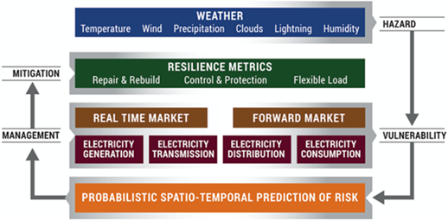
Approach: Model the state of risk (SoR)
The Hazard is probability of inclement weather
The Vulnerability is a conditional probability of faults occurring under inclement weather
The State of Risk (SoR) is a multiplication of the Hazard, Vulnerability and (Economic) Impact
The risk management is done through optimized mitigation measures

Slide 10
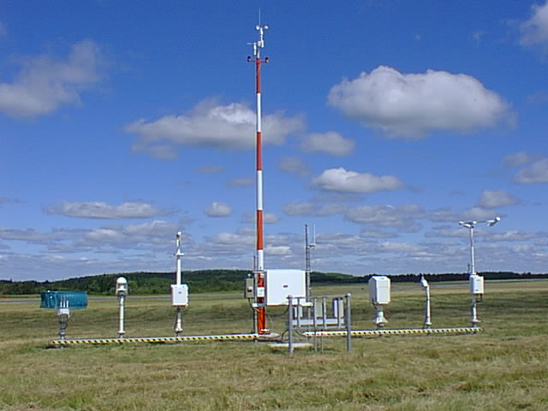
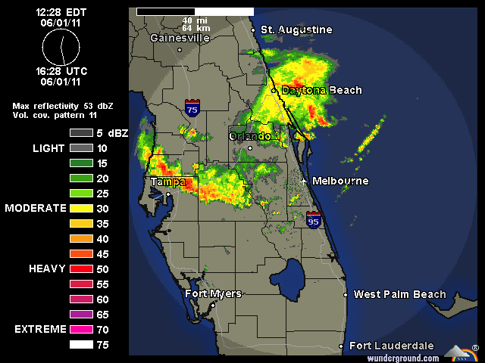
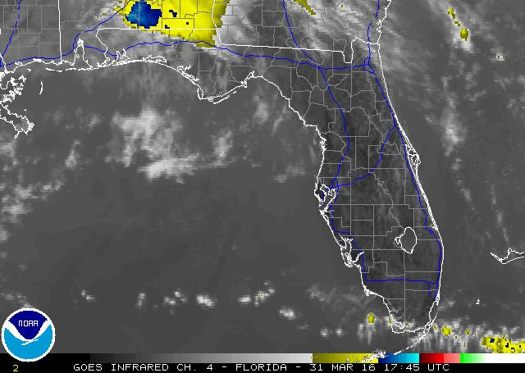
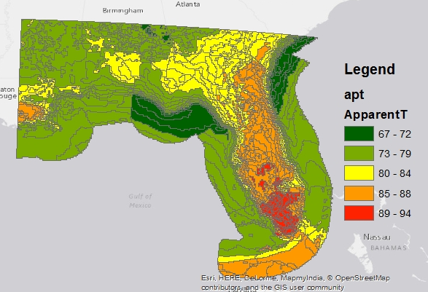
Approach: Model the state of risk (SoR)
Hazard: Weather Data
Weather Station
Radar
Satellite
National Digital Forecast Database (NDFD)
Example: Apparent Temperature
Data download: every 3 hours
Forecast for next 3 days
Data resolution: 3 hours

Slide 11
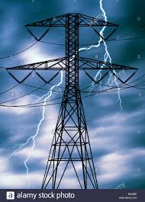
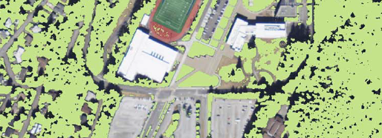
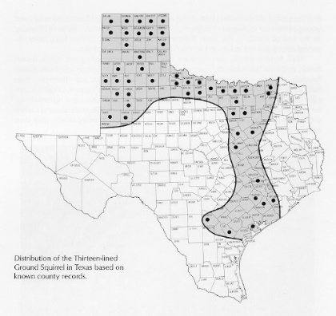
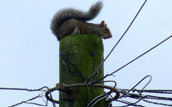
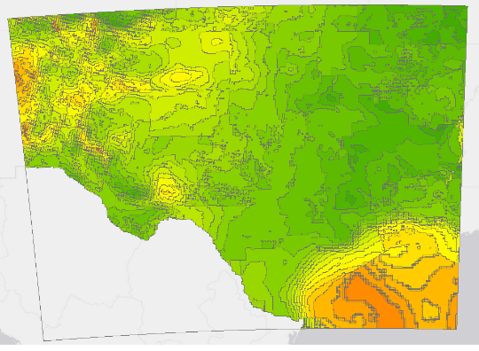
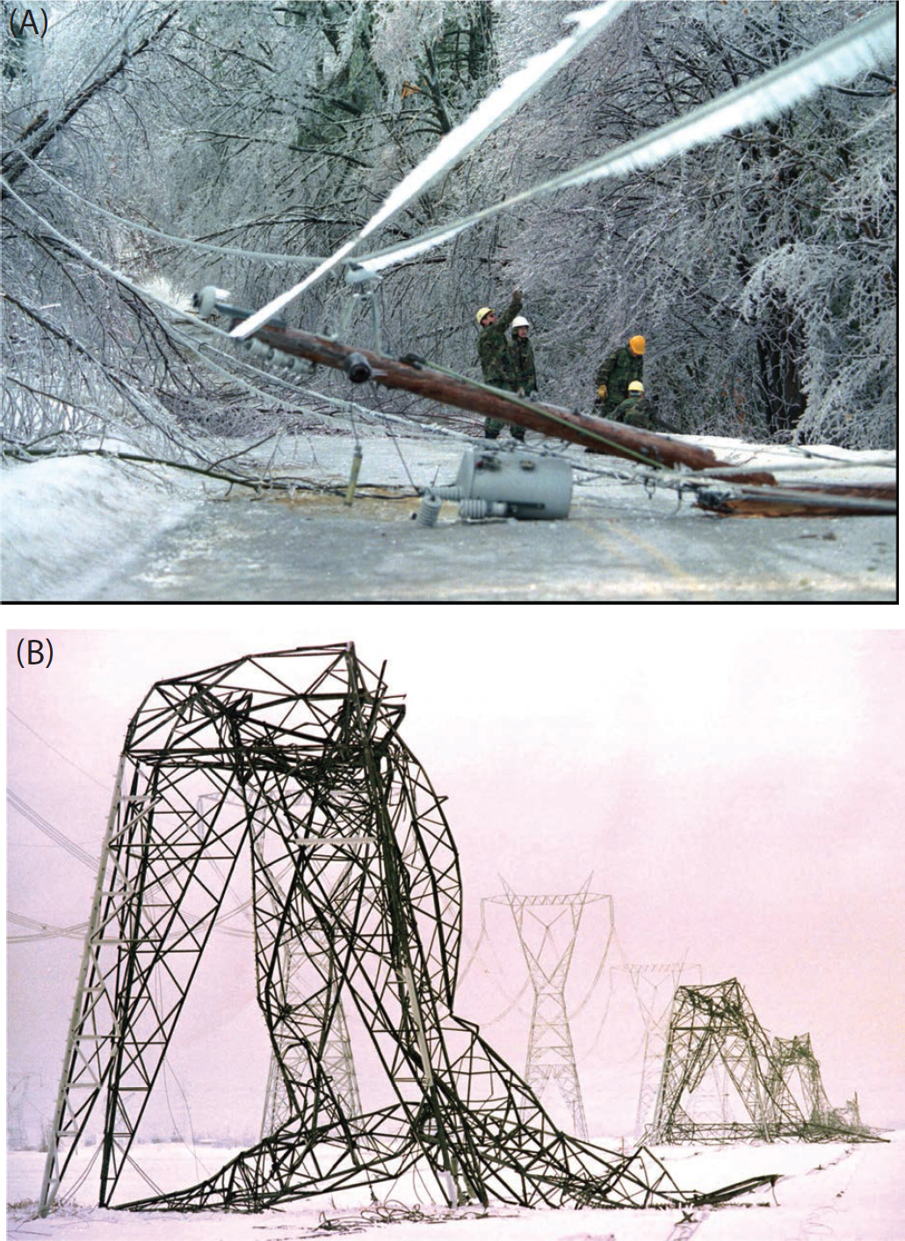
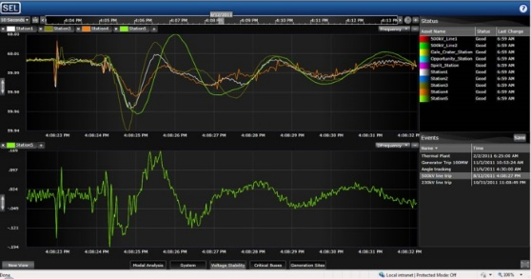
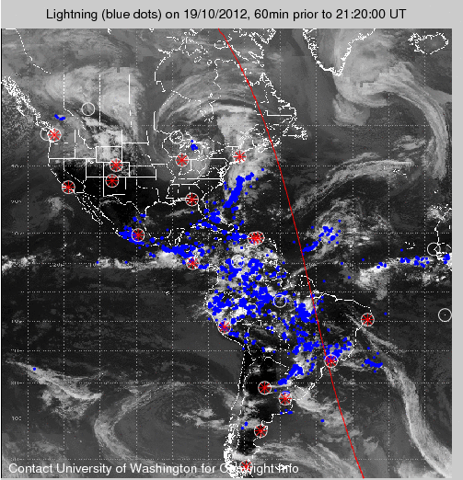
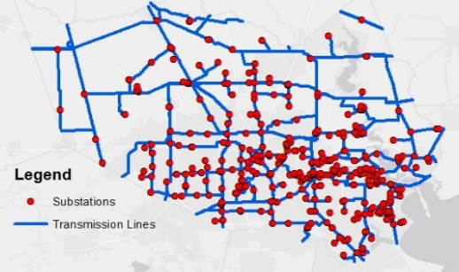

Approach: Model the state of risk (SoR)
Vulnerability: Data reflecting causes
Vegetation Indices
Utility measurements
Weather Forecast
Network Assets
Lightning Data

Slide 12
Approach: Model the state of risk (SoR)
Economic Impact: Outage consequences
Loss of essential electricity delivery services
Consumer inconvenience, safety and casualties
Equipment damages
Electricity market price misbehavior
Societal distrust in the service provider

Slide 13
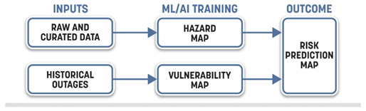
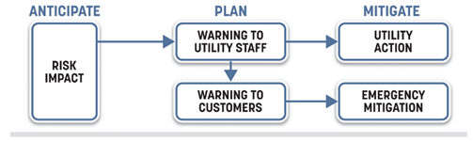
Action: Manage and mitigate the SoR
The SoR may affect: a) utility and b) consumer
The utility SoR management will depend on utility’s mitigation options
The consumer SoR management will depend on consumer’s mitigation options
The mitigation measures are determined through optimization where the objective is different in utility and customer cases

Slide 14
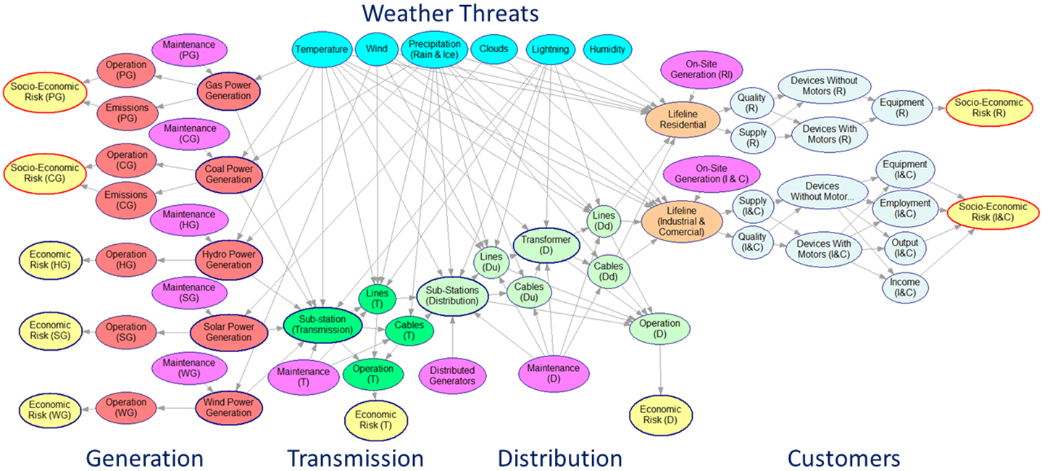
Action: Manage and mitigate the SoR
Risk management granularity

Slide 15
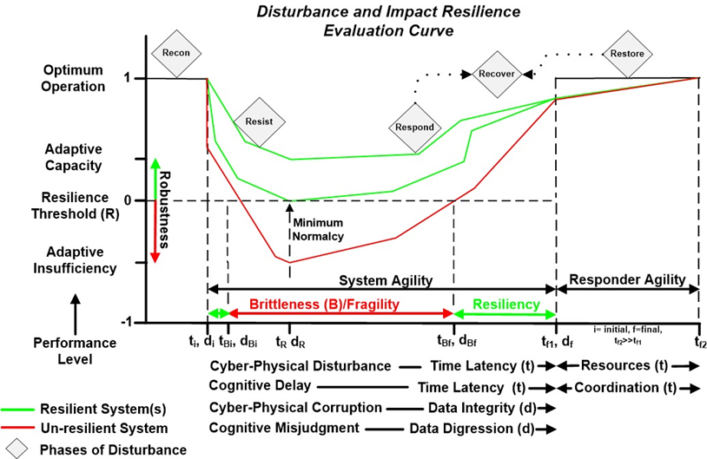
Metrics: Differentiate the SoR vs resilience
Develop SoR models for all grid components
Develop metrics that captures SoR prediction properties
Implement new resilience concept based on SoR management

Slide 16
Metrics: Differentiate the SoR vs Resilience
Performance metrics
Metric | Explanation
Accuracy | The ratio of correctly predicted instances to the total instances. Measures overall effectiveness.
Precision | The ratio of correctly predicted positive observations to the total predicted positives. Measures the accuracy of positive predictions.
Recall (Sensitivity) | The ratio of correctly predicted positive observations to all observations in actual class. Measures the ability to identify all positive instances.
F1 Score | The weighted average of Precision and Recall. Accounts for both false positives and false negatives.
ROC-AUC | The area under the Receiver Operating Characteristic curve. Measures the ability to distinguish between classes.
Confusion Matrix | A table showing true positives, false positives, true negatives, and false negatives. Provides a comprehensive overview of the prediction performance.
Specificity | The ratio of correctly predicted negative observations to all observations in actual class. Measures the ability to identify negative instances.
Matthews Correlation Coefficient (MCC) | A correlation coefficient between the observed and predicted binary classifications. Measures the quality of binary classifications.

Slide 17
Metrics: Differentiate the SoR vs Resilience
Two-step approach
Use the data analytics (metrics) to assess the SoR
Use an optimization approach for selecting the mitigation measures to reduce the risk impact
Open questions
How to interpret the risk assessment results
What objective function and constraints to use for the optimization
Requirement
The end-users (utility and consumer) to specify the risk tolerance level
The end-users to select mitigation measures to reduce the risk impact

Slide 18
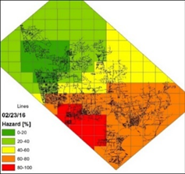
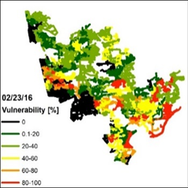
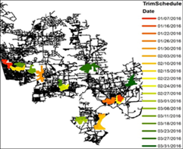
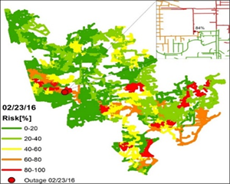
Examples: T&D and grid at the edge
Vegetation-caused distribution outage management
An example of creating spatiotemporal SoR maps is shown clockwise on the graphs
The example is vegetation management, which depends on weather and trees/soil
The hazard map takes either current weather of weather predictions from NDFD
The vulnerability map uses outage historical data reflecting outage causes
The SoR is represented in a GIS overlaying SoR prediction on the electric grid map
Mitigation measures show reduction in the risk due to an optimization of resources
Dokic T., Kezunovic M.: “Predictive risk management for dynamic tree trimming scheduling for distribution networks,” IEEE Trans. on Smart Grid, 2018, 10, (5), pp. 4776-4785

Slide 19
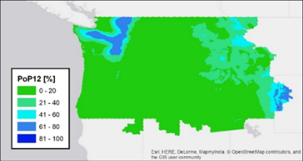
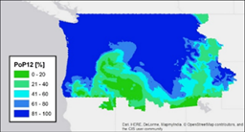
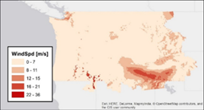
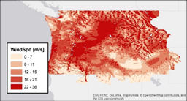
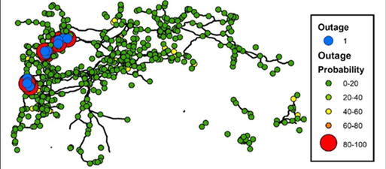
Examples: T&D and grid at the edge
Weather-caused transmission outage management
The weather has been taken from the government weather databases
This utility had 20-year publicly available record of historical outages with causes
The results indicate good coincidence of the actual faults vs what was predicted
The SoR prediction may be used for different purposes: operations and operations planning during forced outages, scheduled outage management due to maintenance planning, and asset management
Kezunovic M., Dokic T., Obradovic Z., Pavlovski M., Said R., “Big data analytics for predictive lightning outage management using spatially aware logistic regression model”, CIGRE General Session, Aug. 2020, Paris, France.

Slide 20
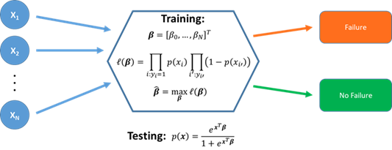
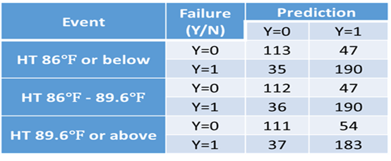
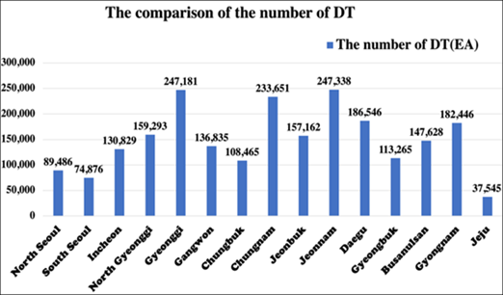
Examples: T&D and grid at the edge
Environment-caused distribution transformer outage management
The Korea Electric Power Company has a plan to increase monitoring of DTs
The alternative we considered was to predict DT outage SoR based on temperature and environmental data only
Hui Ko, E., Dokic T., Kezunovic, M., “Prediction model for the distribution transformer failure using correlation of weather data,” in Trkulja B., Štih Ž., Janić Ž. (Eds.), 5th Inter. Colloquium on Transformer Research and Asset Management, (Springer, ISBN 978-981-15-5600-5, 2020).

Slide 21
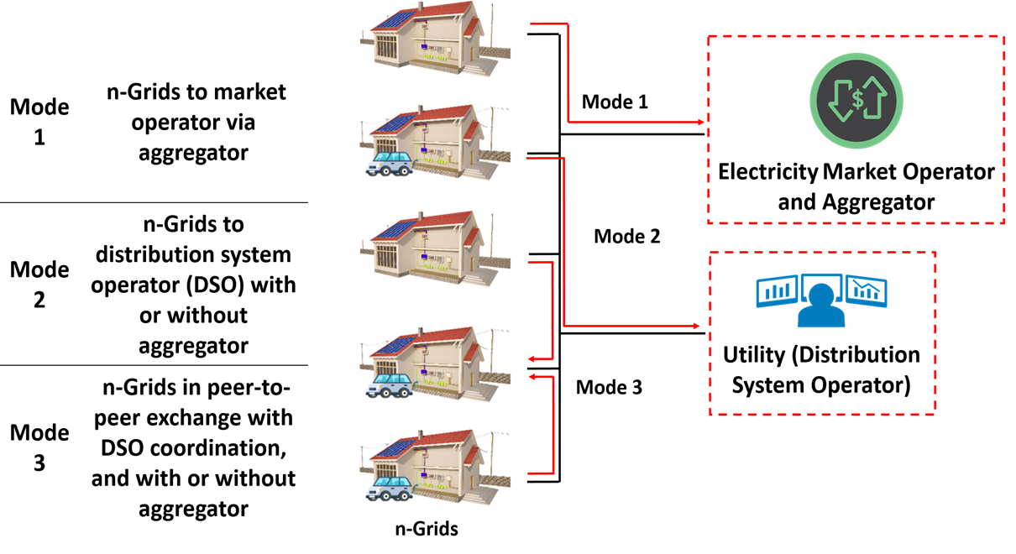
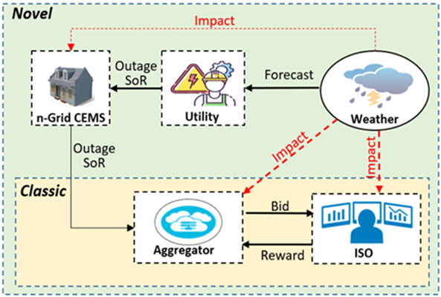
Examples: T&D and grid at the edge
Grid outage-caused flexible load management
The aggregators make estimates of the available energy resources to be offered as ancillary services in the WH market
The ancillary services typically coincide with weather impacts threatening the entire electric grid in a region
The grid outage SoR prediction helps the owners of the flexible load to plan its energy resources in the case they experience outage
The correction of the customer owned flexible energy resources available for aggregation is needed to reduce the risk of the aggregator
Khoshjahan M., Baembitov R., Kezunovic, M.: “Informed prosumer aggregator bidding strategy via incorporating distribution grid outage risk predictions,” IEEE Access, 2023, vol. 11, pp. 28585-28595

Slide 22
Conclusions
Be aware:
The SoR may be defined in many ways, so CONSISTENCY is needed
The SoR prediction is not enough; management and mitigation are CRITICAL
The use of ML/AI requires EXTENSIVE historical data, so be ready to deal with it
The adoption requires new MINDSET, so WORKFORCE TRAINING is needed
Be cautious:
ML/AI solutions are costly, so the RoI needs JUSTIFICATION
The SoR approaches are not common, so finding a CORPORATE champion is a must
This is all about data, so data quality and trustworthiness are IMPORTANT
The legislative, regulatory and societal aspect are PARAMOUNT to the implementation

Slide 23
Acknowledgements
Many researchers and funding parties have contributed to the results
Recent A&M researchers:
- Graduate students, R. Baembitov, A. Karmacharya, T. Mohamed
- Recently graduated, Dr. T. Djokic, Prof. P. Dehghanian, Dr. B. Zhang, Dr. M.
Khoshjahan, Dr. M. Soleimani
Recent Temple researchers:
- Prof. Z. Obradovic, Distinguished Professor; Director, Center for Data
Analytics and Biomedical Informatics, Temple University
- Graduate students, R. Aljurbua, C. Petridis, D. Saranovic,
- Recently graduated, Dr. M. Alqudah, Dr. M. Pavlovski, Dr. A. Abdel Hai
Recent funding parties: NSF, DOE, CenterPoint Energy, CPS Energy, United Co-Operative, PSerc, SGC A&M, INESC-TEC, Portugal.

Slide 24
References
C. Reiz, Clara Gouveia, R. J. Bessa, J. Peças Lopes, M. Kezunovic, “Risk Assessment of Future Power Systems: Assuring Resilience of Electrification for Decarbonization,” Bulk Power System Dynamics and Control - XII, June 2025, Sorrento, Italy, May 2025.
M. Kezunovic, R. Baembitov, and T. Mohamed, “AI is not a Panacea, but it works for fault analysis and outage management”, IEEE Power and Energy Magazine, 2025
M. Kezunovic, “The Role of ML and AI in Managing Forced Outages in Hybrid Energy Systems”, 8th Hybrid Power Plants & Systems Workshop, Azores, Portugal, 14–15 May 2024
R. Baembitov and M. Kezunovic,” State of Risk Prediction for Management and Mitigation of Vegetation and Weather Caused Outages in Distribution Networks” IEEE Access, vol. 11, pp. 113864-113875, October 2023.
M. Kezunovic, P. Pinson, Z. Obradovic, S. Grijalva, T. Hong, and R. Bessa, “Big Data Analytics for Future Electricity Grids” Invited paper, Electric Power Systems Research, Vol. 189, No., pp. 106788, 2020
Dehghanian, B. Zhang, T. Dokic and M. Kezunovic, “Predictive Risk Analytics for Weather-Resilient Operation of Electric Power Systems,” IEEE Transactions on Sustainable Energy, Vol. 10, No., pp. 3-15, January 2019
M. Kezunovic and T.J. Overbye, “Off the Beaten Path: Resiliency and Associated Risk,” IEEE Power and Energy Magazine, vol. 16, no. 2, pp. 26-35, March/April 2018.

Slide 25

Q/A
Together -
building a prosperous future
where energy is
clean, abundant, reliable, safe, secure and affordable

