Slide 1



New Interconnection Projects Between Europe and the MENA Region
Angelo Ferrante, Secretary General Med-TSO
5th SEERC Conference Sarajevo – June 4-5, 2025

Slide 2
Table of contents
Med-TSO at a glance
Mediterranean context and challenges to integration
The Med HV Transmission Network and the MMP 2022
TEASIMED 2 & MMP – MEIP (2040 Scenarios)
The Action Plan 2025 – 2030
Conclusions
2

Slide 3
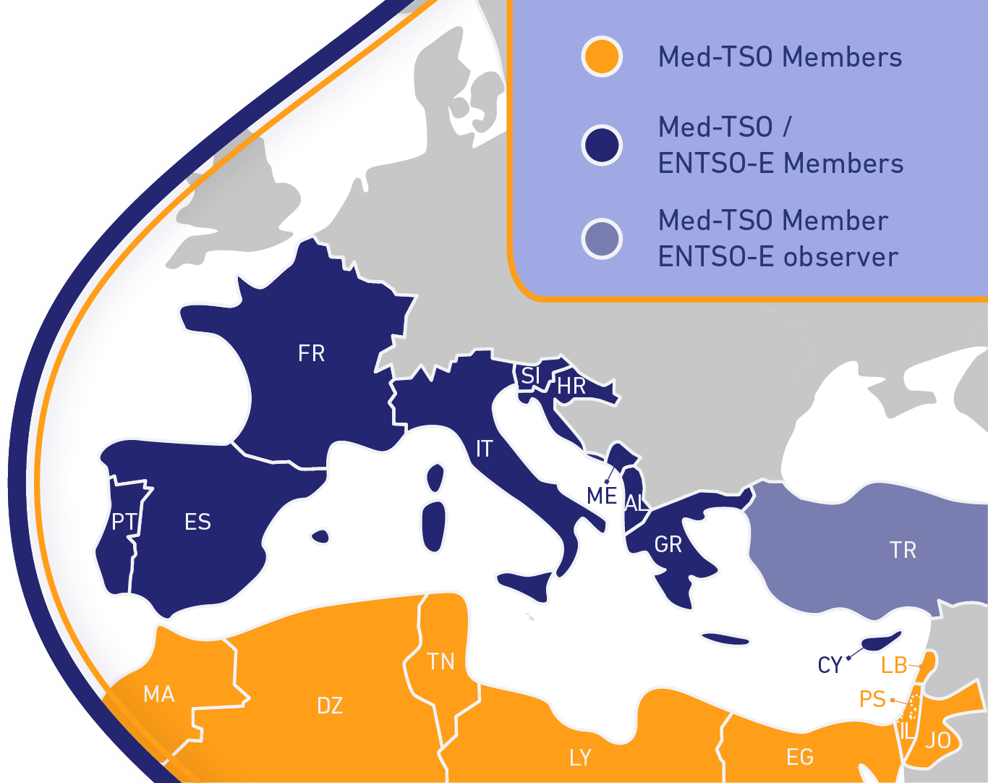
Med-TSO: TSOs at the heart of the Mediterranean Energy Integration
www.med-tso.org
> 500 million people served
~ 544.000 MW installed capacity
~ 400.000 km transmission lines
> 1.600 TWh electricity consumption
Collaborative platform of 20 TSOs across the euro-mediterranean region established in 2012
Unique blend of EU and non-EU member companies from 3 continents
Aiming at a more integrated, secure, and sustainable regional grid
Co-financed by DG NEAR since 2015
SEC hosted in Rome at Terna’s premises

Slide 4



Main pillars of Med-TSO’s action plan
a
b
c
d
Coordinated planning
Common rules
Capacity building
Enhance coordination in operations
Coordinated development of HV grid
Med Masterplan
Power System interoperability
Mediterranean Grid Code
Training
Knowledge Sharing programs
Coordinated Adequacy assessments
Interconnected Electricity Exchange Zones
2015
2018
2020
2023
2025
2
What’s next?

Slide 5
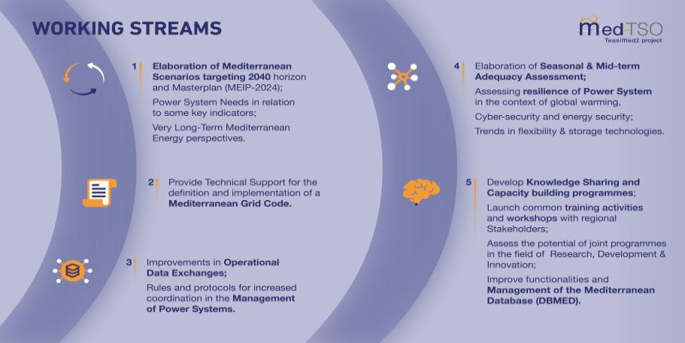
TEASIMED 2 Project (2023-2025)

Slide 6
Table of contents
Med-TSO at a glance
Mediterranean context and challenges to integration
The Med HV Transmission Network and the MMP 2022
TEASIMED 2 & MMP – MEIP (2040 Scenarios)
The Action Plan 2025 – 2030
Conclusions
6

Slide 7
The Mediterranean context
Power System going through a huge transformation
Regional integration: a no-retreat solution for decarbonizing the Med Region because of limited/inefficient use of the grid, market fragmentation, unfavorable climate for investors, asymmetries in legislation and regulation
Benefits of integration not fully understood, countries tend to develop national solutions instead of Regional solutions that could promote pooling of resources and flexibility tools
Lesson learnt: individual countries alone fail to develop or slow down their decarbonization plans
Technical, regulatory and financial regional solutions:
network development plans
grid codes
efficient financing mechanisms
SEE can play a significant role, as one of the doors to Europe: several projects already planned for connecting MENA to Europe through the region

Slide 8

Challenges & opportunities for energy transition in MENA
Institutional challenges: develop an efficient Mediterranean framework
Financial challenges: develop financing instruments to boost long-term & capital-intensive investments in grids
Technical challenges: promote the development of the HV transmission grid and increase the interoperability of PS: requires legal/regulatory support
Interlinked challenges
lack of a solid institutional framework limits investments
lack of investment slows down reforms
TSOs are service providers under existing legal frameworks, limited capacity to modify their practices without strong institutional support

Slide 9
Institutional challenge: setting up regional policies
Develop a comprehensive vision and a real efficient regional policy (a Mediterranean framework) harmonizing national regulations
Integrated network development plans
Med Grid Code (planning, operation, data exchange and market integration
Energy platforms (UfM)
Pan Arab Electricity Market (LAS)
Coordinate the existing institutional initiatives
EU to drive the transformation and implement the external dimension of the EU Green Deal
Foster MENA integration along both N-N and S-S axes (no DII approach)
Achieve data availability and overcome the limited exchange of operational data now blocked by regulatory fragmentation & legal barriers
Regulatory mandates for TSOs to establish secure, interoperable data sharing platforms

Slide 10
Financing mechanisms
Many projects with significant commercial viability but heavy financial gaps
Boost long-term & capital-intensive investments in grids to develop the N-S and S-S electricity infrastructure
De-risk network developments by facilitating anticipatory investments to align with long term policy priorities
New CBA, less limited in perimeter and parameters
Not neglecting the regional impact
Considering additional KPI (not only market-driven) to capture all the projects externalities (long-term socio-economic impact)
Lack of appropriate remuneration schemes combined with countries’ financial weakness endangers the development of the grid
Need of a proactive role of IFIs and DFIs in developing new financing instruments and criteria
ELMED: project assessed in a Euro-Mediterranean perspective
Game changer for the integration of the Med Power System and catalyst for other projects

Slide 11

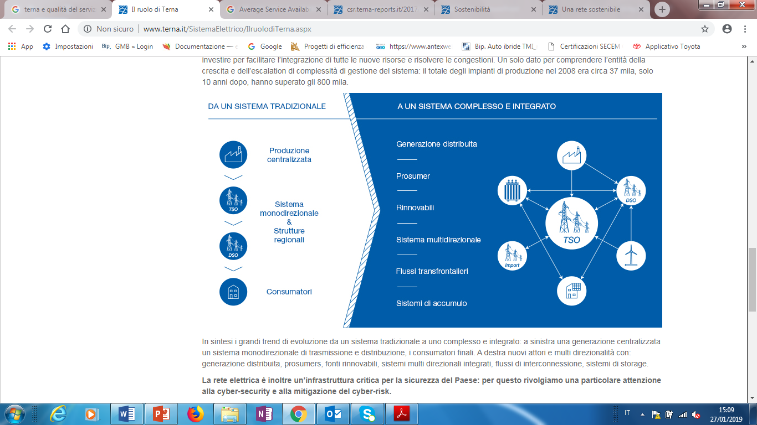


TSOs enablers of the energy transition
Manage an increasingly complex energy system (growing non-dispatchable RES and prosumers):
expansion and development of their grids
integration of flexible assets and services into their grids (to facilitate demand side response and storage)
encouraging associated developments in market design and regulatory frameworks
Med-TSO as a multilateral cooperation platform to develop common tools and methodologies, while promoting mutual trust
provide the technical competence to foster regional integration
support the effective development of the grid also on the S-S axis
develop a tight cooperation among Members AND Institutions, IFIs and stakeholders
Action Plan 2025-30 to identify needs and proposes activities to progress in the creation of a Euro-Mediterranean interconnected HV Transmission Network

Slide 12








Cooperation with main stakeholders
Supporting Med-TSO work programme since 2015
MoU signed with the League of Arab States for developing common initiatives
Gradual approach
No one-size-fits-all solutions
Sub-regional approach
Med-TSO is active stakeholder in Ufm REM Platform
Cooperation framework since 2014
Long-term joint cooperation agreement since 2017
Cooperation within UfM energy platforms and strengthened collaboration for the development of long-term energy scenarios
12

Slide 13
Table of contents
Med-TSO at a glance
Mediterranean context and challenges to integration
The Med HV Transmission Network and the MMP
TEASIMED 2 & MMP – MEIP (2040 Scenarios)
The Action Plan 2025 – 2030
Conclusions
13

Slide 14
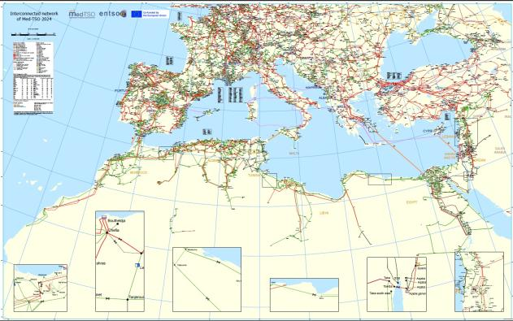
The Mediterranean electricity map
The first issue to tackle: promoting the development of the grid
14

Slide 15
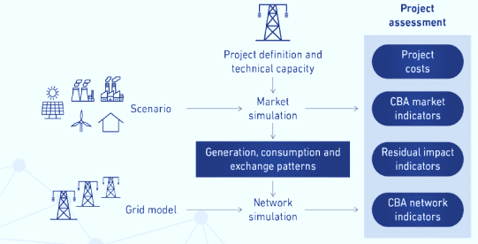
The Mediterranean Masterplan
A set of coherent activities:
definition of consistent energy scenarios
selection of the future interconnection projects
set up of a reference model of the regional power system to perform market and network studies
Analysis of the network behavior (load flow calculations) and of the investments needed to fulfil the security requirements
Perform a shared Cost-Benefit Analysis (CBA) for the new investments
15

Slide 16
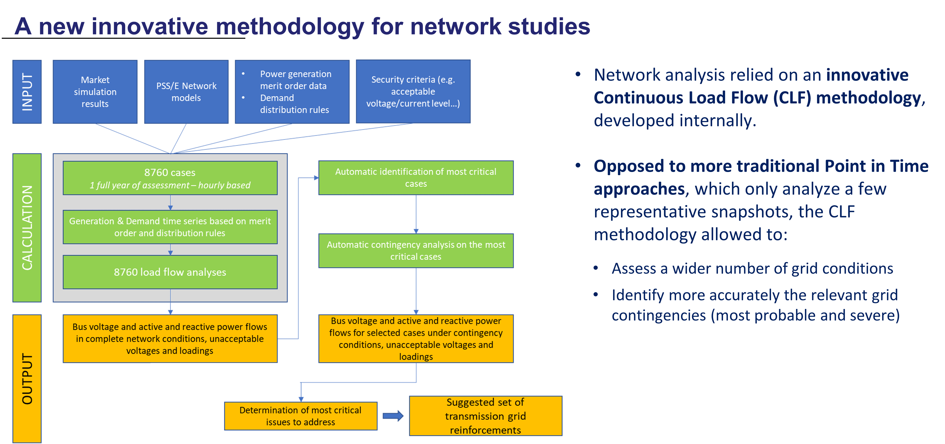
A new innovative methodology for network studies
16

Slide 17
Coordination of Network development
For each study, scenarios are built in agreement with all stakeholders, including also ENTSO-e
Scenarios
Investments costs
For each new project identified, the project investment cost is calculated according to harmonized cost methodologies
Med-TSO
Coordinated
Long term planning studies
The methodology used for the cost-benefit assessment (CBA) has been developed to
evaluate the benefits and costs of new interconnection projects, providing useful data
and indicators for their assessment.
Cost-benefit analysis
Merits for the project assessment
Welfare, Sustainability and Security of Supply (SoS)
Resolving isolation (Lebanon, Cyprus)
Improve Operation & Flexibility
Improve energy exchanges
17

Slide 18
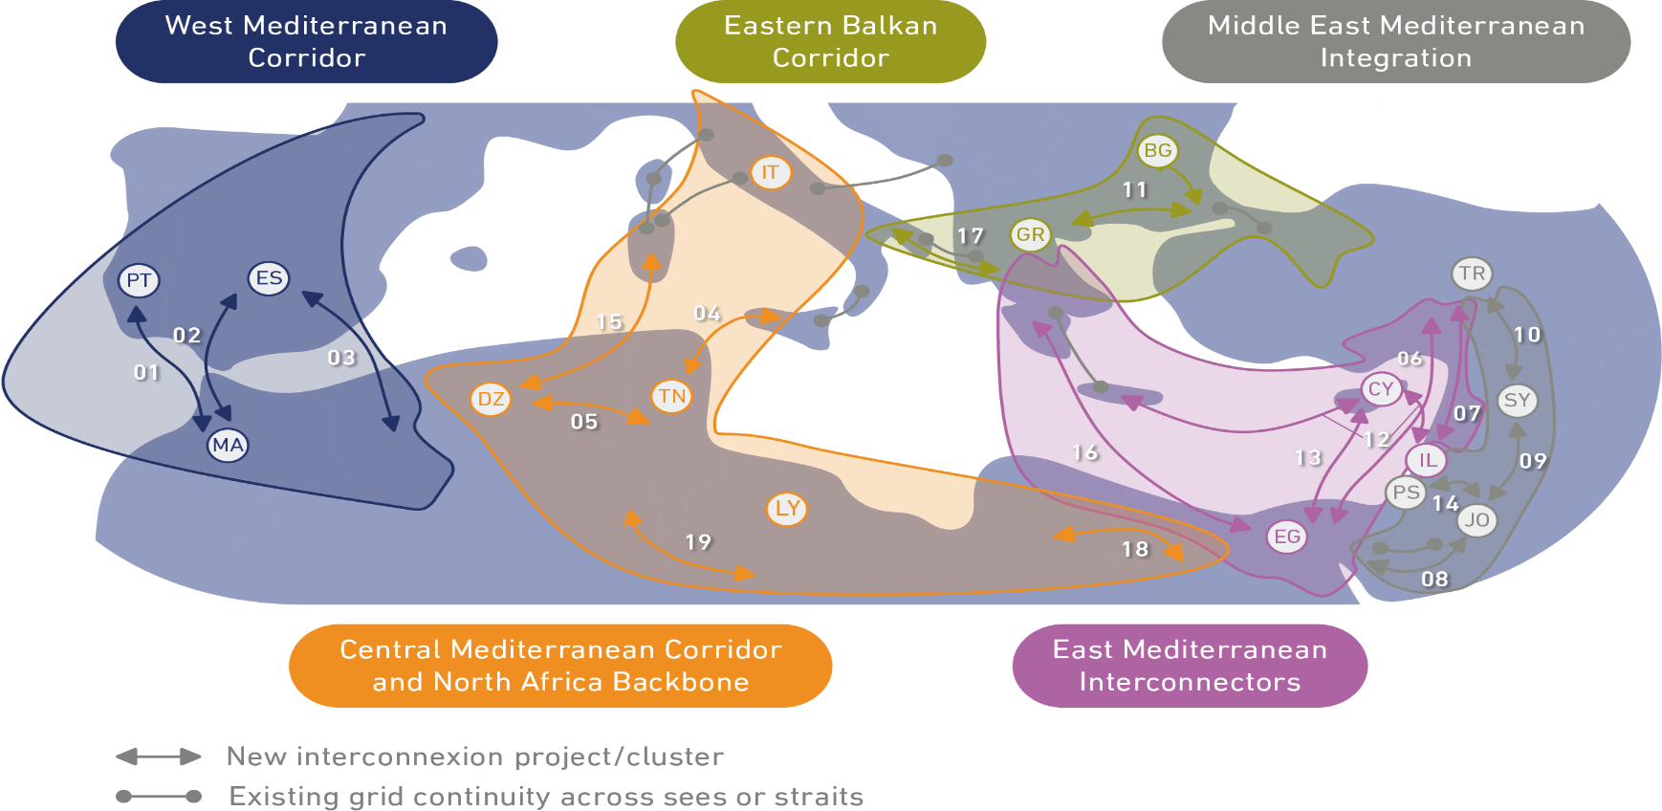
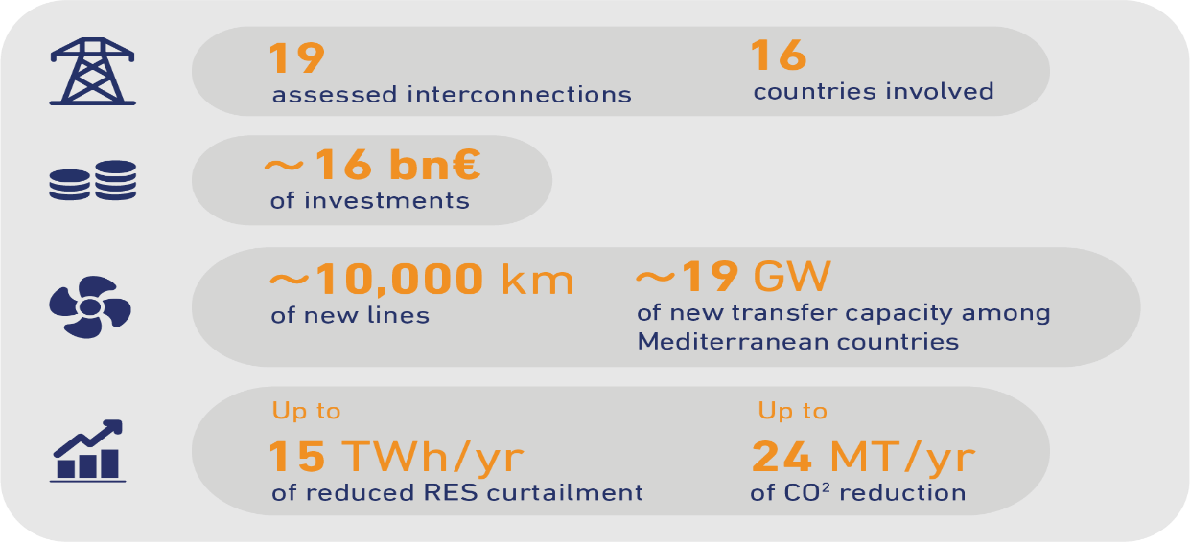
The 2022 Master Plan outcomes (time horizon 2030)
# | Project Name | Nominal Capacity [MW] | Technology
1 | Morocco – Portugal | ±1000 | HVDC
2 | Morocco - Spain | +650/-600 | HVAC
3 | Algeria - Spain | ±1000 | HVDC
4 | Tunisia - Italy | ±600 | HVDC
5 | Algeria - Tunisia | ±750 | HVAC
6 | Egypt - Turkey | ±3000 | HVDC
7 | Israel - Turkey | ±2000 | HVDC
8 | Egypt - Jordan | ±550 | HVAC
9 | Jordan - Syria | ±1000 | HVAC
10 | Syria - Turkey | ±600 | HVAC
11 | Bulgaria - Greece - Turkey | BG-TR: +1100/-700 TR-GR: ±600 | HVDC
12 | Israel - Cyprus - Greece | IL-CY: ±1000 CY-GR: ±1000 | HVDC
13 | Egypt - Cyprus | ±1000 | HVDC
14 | Jordan - Palestine | ±200 | HVAC
15 | Algeria - Italy | ±1000 | HVDC
16 | Egypt - Greece | ±2000 | HVDC
17 | Italy - Greece | ±500 | HVDC
18 | Egypt - Libya | ±1000 | HVAC
19 | Algeria - Libya | ±1000 | HVAC
https://masterplan.med-tso.com
https://data.med-tso.com
18

Slide 19
Table of contents
Med-TSO at a glance
Mediterranean context and challenges to integration
The Med HV Transmission Network and the MMP
TEASIMED 2 & MMP – MEIP (2040 Scenarios)
The Action Plan 2025 – 2030
Conclusions
19

Slide 20
TEASIMED 2: a new approach
Important improvements: analyses split in two, defining consistent energy scenarios in 2 different time horizons (2030 & 2040)
update mature projects with renewed 2030 scenarios (MMP2025)
study future interconnection projects for the time horizon 2040 (1st Mediterranean Electricity Interconnection Perspectives, MEIP) to have reliable and de-risked anticipatory investments
Extended perimeter: Gulf countries and Saudi Arabia
Long-term planning critical in the Med region: lack of reliable data for many non-EU countries)
20

Slide 21
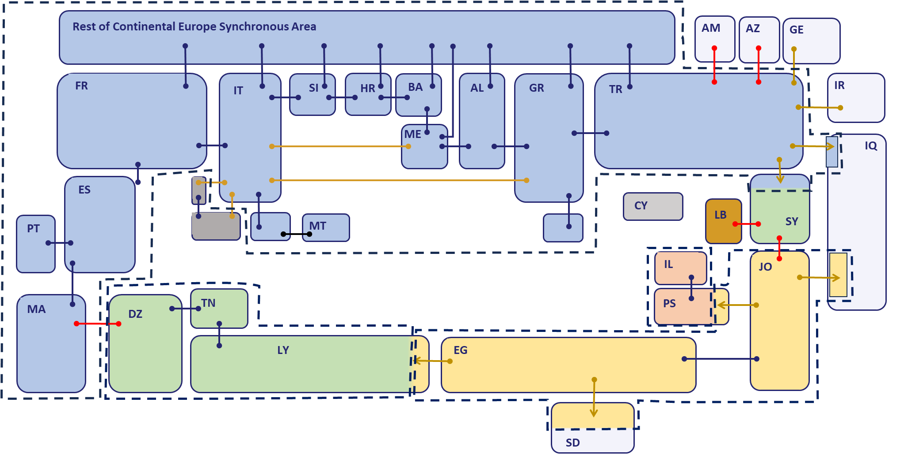
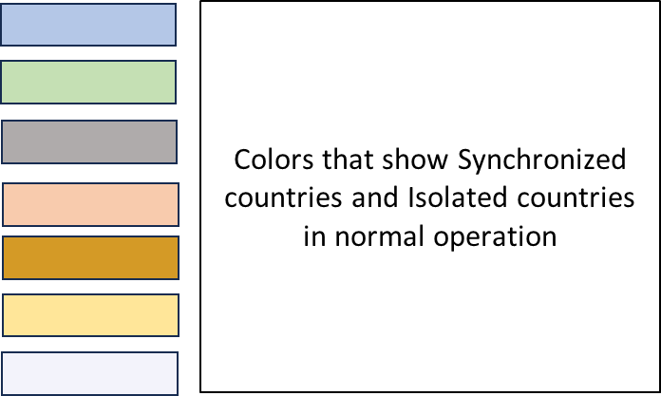
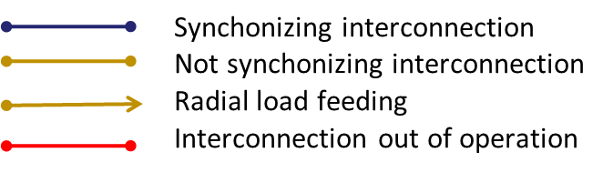
Med-TSO Interconnectivity Map - May 2025
21

Slide 22
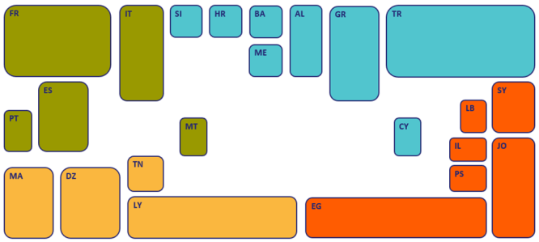
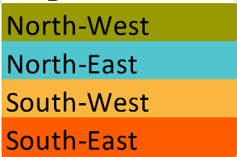
Modelling the Mediterranean countries for MMP & MEIP
Countries present in our Market model (detailed data for load, aggregated generation, internal modeling, open-source software)
All the EU countries also present with the same level of detail
Border conditions (predetermined hourly exchange time series) : EG-KSA, EG-SD, JO-KSA, JO-IQ
Our model can be easily extended to neighboring countries (Gulf) if data are accessible
22

Slide 23
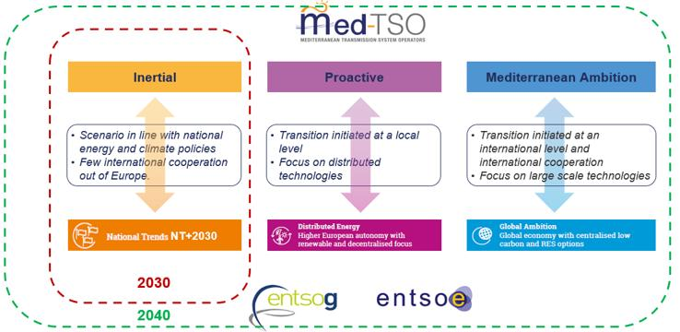
Mediterranean Energy Scenario
23

Slide 24
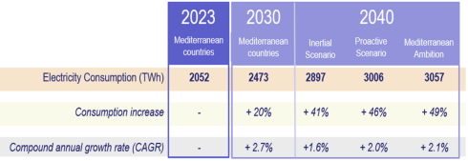
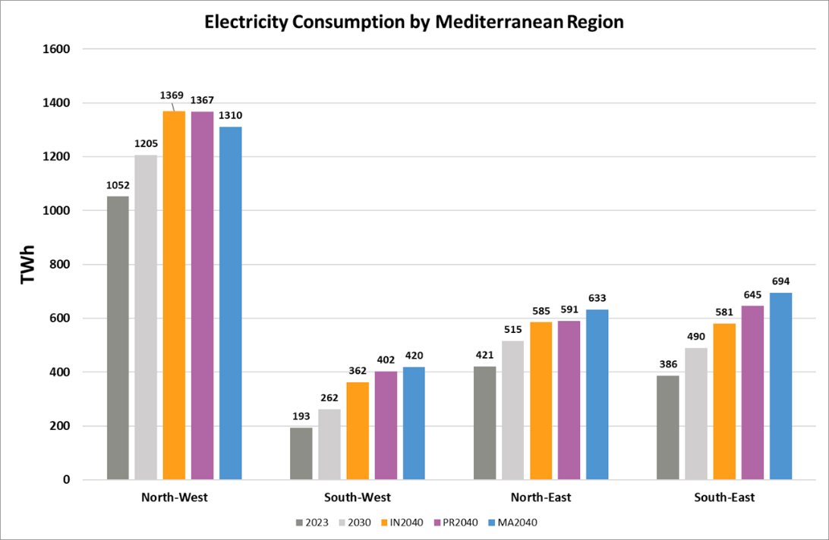
Electricity demand 2030 - 2040
Higher consumption in Proactive and Mediterranean Ambition scenarios: more favourable economic growth and stronger electrification (mobility, industry, heating)
Contrasting dynamics between Med countries
In Europe increase is driven by shift from fossil fuel
In MENA countries increased electrification is more visible in the Mediterranean Ambition scenario, under the assumption of implementing regional cooperation policies across the Mediterranean
Electricity consumption appears slightly lower in the Mediterranean Ambition scenario in Europe, due to increased use of hydrogen, especially in industry and transportation
24

Slide 25
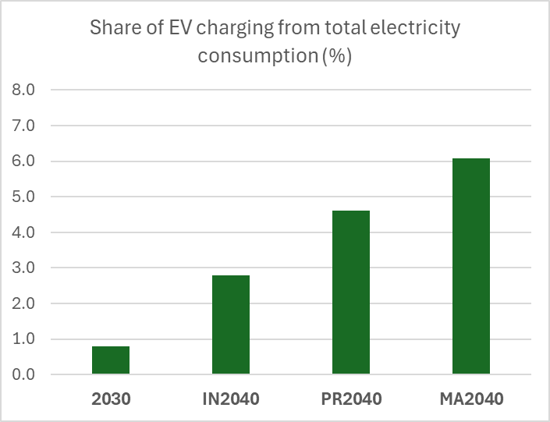
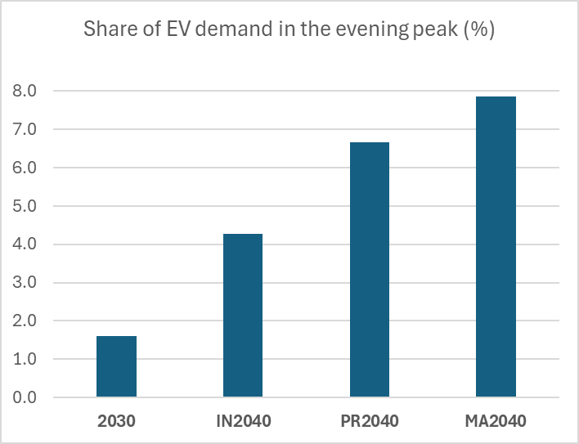
The role of EV
25

Slide 26
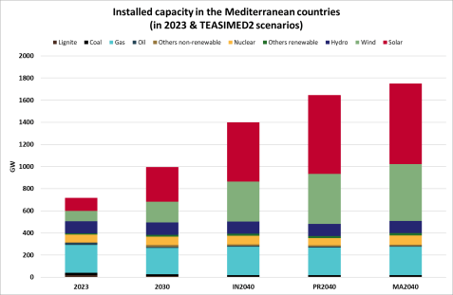
Installed generation capacity
Growth in installed capacity is almost in solar and wind energy
RES account for 46% in 2023, 63% in 2030, and between 73% and 79% in 2040 (excluding storage)
Coal-fired PP decrease from 23 GW in 2023 to 14 GW in 2040 (3/4 in Türkiye)
Lignite-fired PP marginal by 2040 (4 GW, Türkiye and Balkan countries)
Gas-fired PP remain stable (approximately 250 GW) by 2040, significantly decreasing in NW (from 110 to 80 GW
New NPP planned in Türkiye (9 GW) and Egypt (5 GW); existing plants in Spain (7 GW) expected to be shut down by 2040 For France, the outlook for 2040 remains contrasted across the three scenarios (between 50 and 66 GW)
26

Slide 27
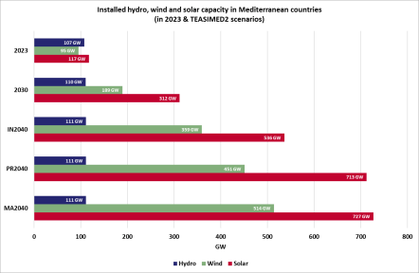
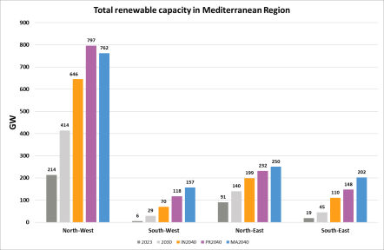
Installed hydro, wind and solar in Mediterranean
Cumulative capacity increase from 330 in 2023 to 630 GW in 2030, and then in the range 1030 - 1370 GW in 2040
Solar installed capacity in 2040 could be 4 to 6 times compared to 2023
Wind installed capacity in 2040 could be 3 to 4 times compared to 2023
Overall trend well distributed across the entire region
27

Slide 28
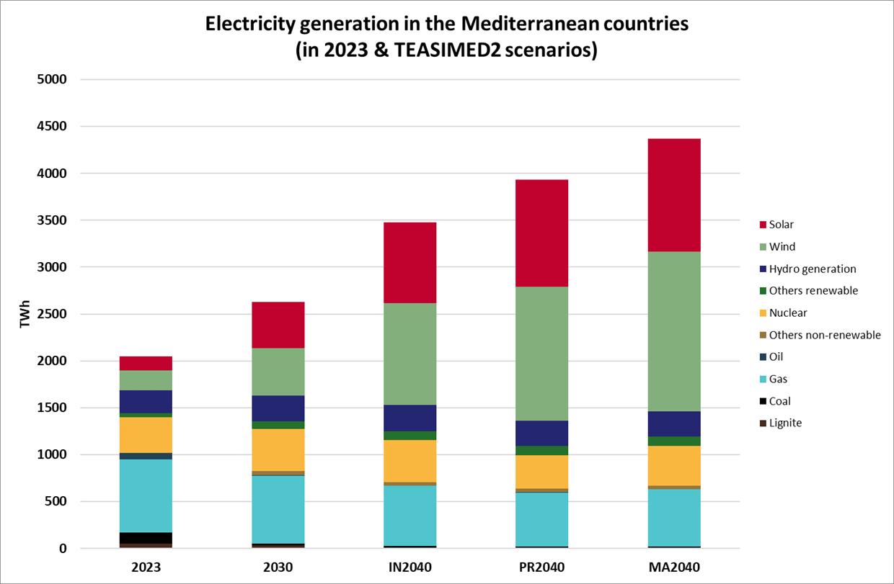
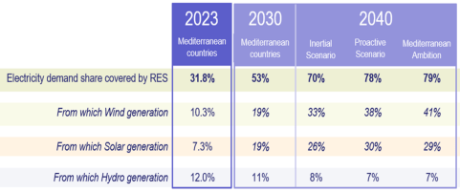
Electricity generation in the Mediterranean countries
Increase in RES production driven by electricity consumption and demand for green hydrogen production
Electricity production grows by 30% in 2030 compared to 2023, and by 70% to 110% in 2040
Coal, lignite, and fuel oil account for less than 1% in 2040 compared to 11% in 2023
Gas-fired generation decreases from 780 TWh in 2023 to 600 TWh in 2040, despite a similar installed capacity
Growth in electricity production exclusively met by RES for all regions combined
28

Slide 29
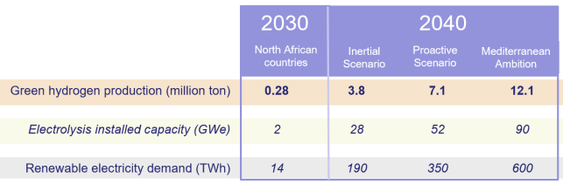
Green hydrogen production in North Africa
Green hydrogen production in North Africa could range from 4 to 12 million tons by 2040
In Mediterranean Ambition this production would require dedicated 600 TWh from RES supplied electrolysers
29

Slide 30
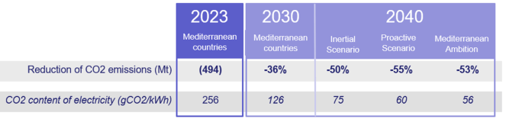
Reduction of CO2 emissions in Mediterranean
CO₂ emissions are expected to decrease by 36%: significant reduction of coal and lignite (no CCS in the Mediterranean) and massive development of RES
30

Slide 31
Table of contents
Med-TSO at a glance
Mediterranean context and challenges to integration
The Med HV Transmission Network and the MMP
TEASIMED 2 & MMP – MEIP (2040 Scenarios)
The Action Plan 2025 – 2030
Conclusions
31

Slide 32
Med-TSO Action Plan 2025-30: strategic objectives
Med Planning Studies
Analysis third-party projects
Very long-term scenario
(25-year horizon)
Objective 1 : support the development of interconnections and National Grids (Hardware)
Objective 3:
enhance collaboration among Members Stakeholders, Policy-makers, Regulators and IOs for common challenges
(Connections)
Objective 2 : support the Members to cope with massive RES penetration (Software)
Tec Req Guide for RES Integr.
Markets and PS Organiz. in RES Integr.
Enhance SCADA & Dispatch centers comm.
Adequacy Studies
Support the creation of IEEZ
Enhance data sharing
KS and Capacity building
Provide support to the EC for its institutional initiatives
32

Slide 33
From objectives to work streams & activities
1
Assessing the Grid of Tomorrow: Med-TSO Long-term planning studies
Mediterranean Planning Studies
Analysis of third-party projects
Very long-term scenarios
(25-year horizon)
Enhance regional coordination in network planning addressing two different scenario timeframes
Mid-term (5–10 years), for mature projects (MMP)
Long-term (up to 20 years), to develop Mediterranean Electricity Interconnection Perspectives (MEIP)
Assess third-party projects as an independent and qualified advisor, using the same methodology applied in the MMP
Provide capacity building for MENA countries to develop energy scenarios and assess reliable strategies and targets, combining bottom-up and top-down approaches
Propose services to external stakeholders (including IFIs, offering customized assessments)
Extend the analysis to neighbouring regions, such as the Gulf Area
Activity Consolidation
New Activity
Identify Power System needs, aligned with regulatory and policy objectives
33

Slide 34
From objectives to work streams & activities
2
Preparation for massive RES Integration
Technical Requirements Guide for Massive RES Integration
Role of Markets and Power System Organization in Massive RES Integration.
Developing and maintaining a Guide outlining key technical requirements, studies, methodologies and practices to be undertaken or implemented for integrating intermittent RES into grids, based on the experience gathered from the Members
Main chapters of the Guide will be
Key Technical Requirements for RES integration
Advanced Forecasting Tools for improved grid management
Flexibility and RES impact assessment tools and guidelines, including the role of ESS
Provide Members and institutional stakeholders with a comprehensive overview of how energy market design and system organization influence the development and integration of RES
Activity Consolidation
New Activity
34

Slide 35
From objectives to work streams & activities
3
Connecting the Region: Promote the integration of Power Systems
Support the creation of Interconnected Electricity Exchange Zones (IEEZs)
Enhance communication among SCADAs, Dispatch centers
Adequacy Studies
(from Short to Mid-Term)
Addressing inefficient use of interconnections through Med-TSO proposal for a three-phase transition:
to move from the existing agreements towards a market-based framework, highlighting also the required institutional and regulatory developments
Support the Members to improve the exchange of real-time data, highlighting the necessary communication protocols modifications between SCADA (Supervisory Control and Data Acquisition) systems and dispatching centers
Provide the Members and Stakeholders with Seasonal and Mid-term adequacy assessments
Extend adequacy studies to short (weekly) and quasi-real time assessments
Extend the studies to more MENA countries
Cooperate with LAS, that has already endorsed the model, in view of the launch of a pilot project EG-JO-SA, where Med-TSO will actively support its members in making this initiative operational
Activity Consolidation
New Activity
35

Slide 36
From objectives to work streams & activities
4
Data Sharing and Knowledge Sharing: the backbone of the system
Enhance data sharing
Knowledge Sharing and Capacity building
Strengthen data sharing procedures and improve data transparency with key stakeholders
Strengthen KS and Capacity Building programmes to fill up gaps that may hinder the implementation of the Action Plan
Update the Mediterranean Database to match with the new needs of the Action Plan
Implement cooperation plans with regional stakeholders, academia and industry experts
Activity Consolidation
New Activity
36

Slide 37
Table of contents
Med-TSO at a glance
Mediterranean context and challenges to integration
The Med HV Transmission Network and the MMP
TEASIMED 2 & MMP – MEIP (2040 Scenarios)
The Action Plan 2025 – 2030
Conclusions
37

Slide 38
Possible concrete actions
Support institutional initiatives (LAS, UfM)
Launch a regional TSO/Regulator WG to draft Grid Code chapters, building on ENTSO E templates
Pilot an operational data exchange trial among a subset of neighboring TSOs
Seek EC support for binding regional protocols and seed financing for digital infrastructure
Call for collaboration among TSOs, regulators, ministries and donors to align on timelines, roles and funding
Capacity building initiatives and secondments to share ENTSO-E best practices with MENA TSOs
A Mediterranean Grid Code is essential to unlock full capacity of existing assets, accelerate RES integration and strengthen regional security of supply
Med TSO stands ready to lead the technical workstream— but we need regulatory mandate and institutional backing to turn ambition into reality
38

