Slide 1
SOUTH EASTERN REGIONAL COUNCIL OF CIGRE (SEERC)
CIGRE Administration Council
Meeting
Paris
August 24, 2024
Edhem Bičakčić, SEERC President

Slide 2
Introduction to SEERC
SEERC Organizational Structure
What is SEERC?
The South-East European Regional council of CIGRE is one of four CIGRE regional councils and has 17 member countries including Austia and Ukraine.
Role and Impact: SEERC aims to advance knowledge in the energy sector, focusing on sustainable and efficient energy solutions. The organization fosters regional cooperation and knowledge exchange.
Management Board (MB): Responsible for strategic decisions and governance, ensuring alignment with CIGRE's global objectives.
Technical Advisory Committee (TAC): Focuses on technical developments and innovations in the energy sector, coordinating regional working groups.
Regional Working Groups (RWGs): Specialized groups focusing on specific topics such as energy efficiency, decarbonization, and market development.

Slide 3
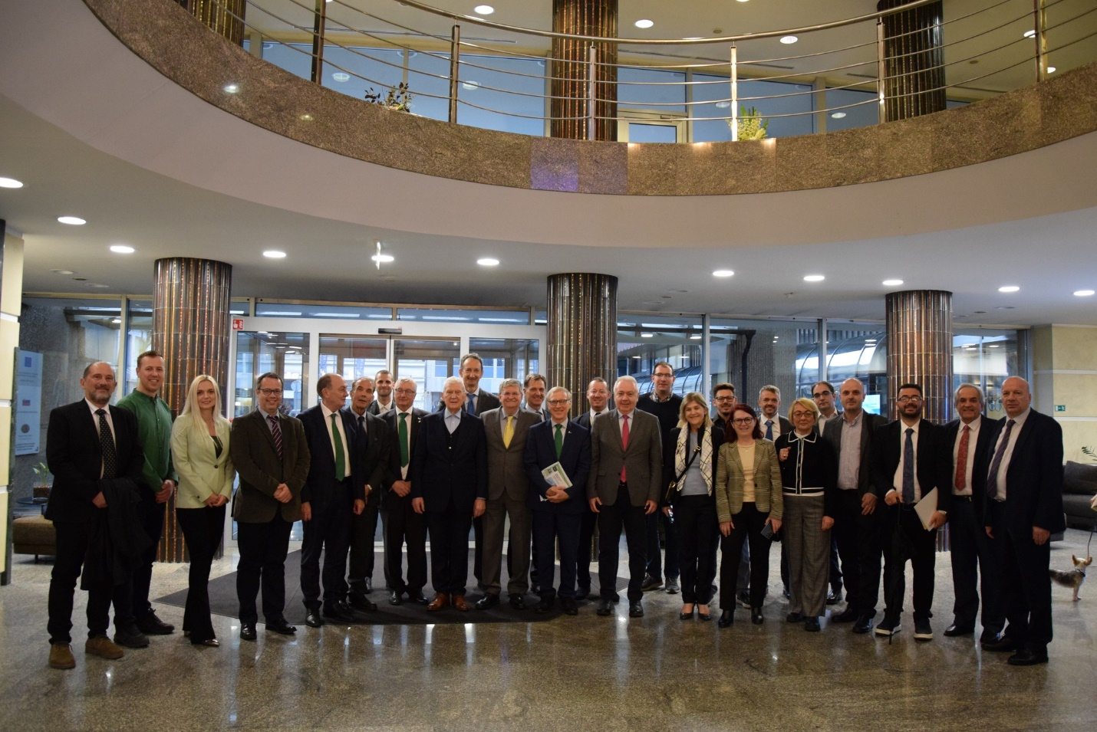
Recent Leadership and Events
Bosnia and Herzegovina's Presidency: Bosnia and Herzegovina assumed the SEERC presidency in 2023, under the leadership of Edhem Bičakčić, focusing on regional energy cooperation.
Key Events Organized:
Joint meeting of SEERC MB and TAC in Ljubljana (Slovenia) on February 28, 2024.
Second CIGRE SEERC Colloquium in Ljubljana (Slovenia) on February 29, 2024.
TAC meeting in Cavtat (Croatia) on May 27, 2024.
7th SEERC Workshop in Cavtat (Croatia) on May 28, 2024.
Upcoming Conference: Preparations for the 5th SEERC Conference in Sarajevo, set for 2025, focusing on cutting-edge energy topics.
Joint meeting of SEERC MB and TAC in Ljubljana, 2024

Slide 4
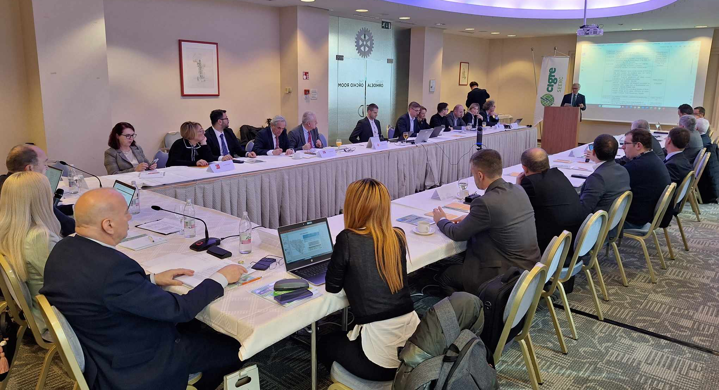
SEERC MB/TAC Meeting in Ljubljana, February 28, 2024
Key Discussions and Decisions: The joint SEERC MB and TAC meeting focused on strategic alignment, operational efficiency, and future planning for the 5th SEERC Conference.
Significant Outcomes: Election of new TAC Chairperson, workshops instead of new RWG’s, and decisions on preferential topics for upcoming SEERC conference.
Focus: Regional collaboration, establishment of MB and TAC.
Notable Outcomes: 16 out of 17 members submitted proposals for new MB and TAC members.
CIGRE SEERC MB/TAC Meeting in Ljubljana, February 28, 2024

Slide 5
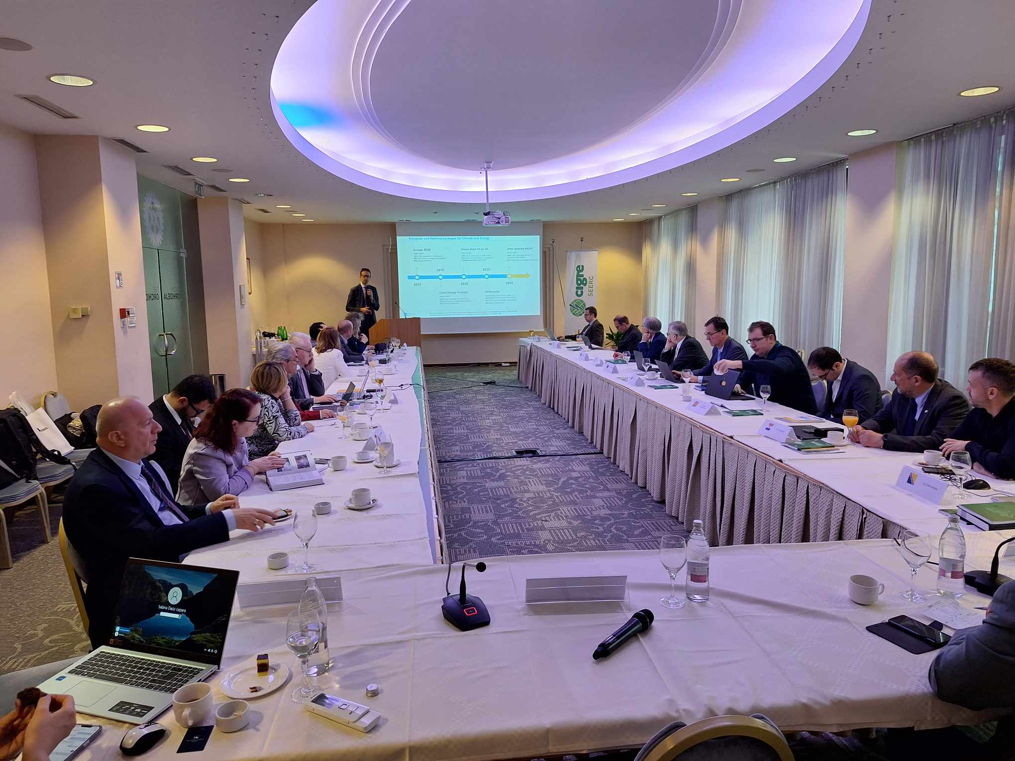
Second CIGRE SEERC Colloquium in Ljubljana, February 29, 2024
Theme: National Strategies for Decarbonization of the Energy Sector and Impacts on the Electric Power System: The colloquium featured presentations on various national strategies of SEERC members for decarbonization and the challenges of integrating renewable energy sources into power systems.
Expert Presentations: Experts from CIGRE national committees shared insights on their countries' progress and challenges in the energy transition.
Key Focus Areas: Discussions centered on energy efficiency, renewable energy integration, and the impacts of new technologies on the electric power system.
SECOND CIGRE SEERC Colloquium in Ljubljana, February 29, 2024

Slide 6
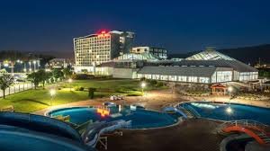
10th TAC Meeting and Conference Preparations in Cavtat, May 27, 2024
Main topic of the Meeting was preparations for 5th SEERC Conference:
Dates: June 4-5, 2025
Location: Hotel Hills, Sarajevo
Confirmed Topics:
1. Increasing energy efficiency of existing facilities and increasing renewable energy capacities
Technologies to improve energy efficiency and encourage the adoption of renewable energy sources and decreased emissions of greenhouse gases; presenting interesting projects.
Advantages of energy efficiency, including diminished energy expenditures, and enhanced energy dependability, energy audits, regulations, energy management systems.
Renewable energy technologies, economic and environmental benefits of solar, wind, hydropower, and geothermal technology; regulatory frameworks for funding; collaborations between the public and private sectors.
2. New technologies and methodologies for accelerated decarbonization and digitalization of electric power systems
Advanced renewable energy integration and storage solutions.
Internet of things, machine learning and smart grid technologies (artificial intelligence, sensor integration and predictive maintenance).
Citizen’s initiatives (energy communities, prosumers, e-mobility).

Slide 7
10th TAC Meeting and Conference Preparations in Cavtat, May 27, 2024
3. Development of the electricity market balancing and dynamic regulation
Integration of national balancing markets in Europe, harmonization of requirements for Balancing Service Providers.
Opening of ancillary service markets to distributed energy resources
and TSO/DSO cooperation.
Storage device evolution, technical and economic performances,
short/medium term measures for balancing the grid and managing the
electric system in the long term.
4. Resilience issues of the electric power systems
The impact of climate change on the electric power infrastructure and the functioning of the electric power system.
Electric power system adaptation concepts, strategies and innovative solutions to increase operational resilience.
Electric power system security and resilience against cyber threats.

Slide 8
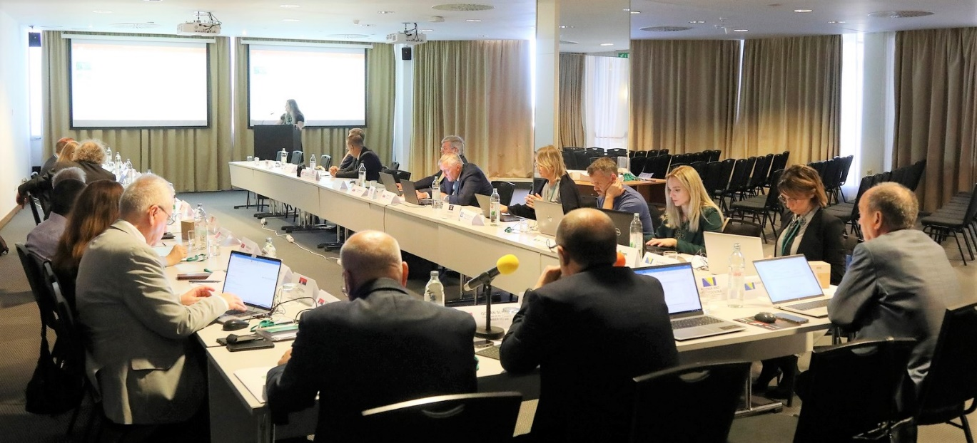
10th TAC Meeting and Conference Preparations in Cavtat, May 27, 2024
The key Conference dates are:
• Synopses Submission Deadline 31.10.2024.
• Notification of Synopses Acceptance 15.12.2024.
• Full Paper Submission Deadline 28.02.2025.
• Notification of Paper Acceptance 31.03.2025.
The conference chairs and co-chairs for the themes are:
- Honorary Chair: Klaus Fröhlich, President of CIGRE PARIS when SEERC was founded.
- General Chair: Edhem Bičakčić, SEERC President.
- Technical Chair: Sabina Dacić-Lepara, SEERC TAC President.
- Publication Chair: Adnan Mujezinović.
Chairs and Co-Chairs for the preferential themes:
1. Increasing energy efficiency of existing facilities and increasing renewable energy capacities
- Chair: Krešimir Bakič (NC Slovenia)
- Co-Chairs: Anes Kazagić (NC B&H) and Gazmend Kabashi (NC Kosovo)
2. New technologies and methodologies for accelerated decarbonization and digitalization of electric power systems
- Chair: Klemens Reich (NC Austria)
- Co-Chairs: Ajla Merzić (NC B&H) and Ümit Çetinkaya, NC Turkey
3. Development of the electricity market balancing and dynamic regulation
- Chair: Enrico Maria CARLINI (NC Italy)
- Co-Chairs: Dalibor Muratović (NC B&H) and Nikola Tošić (NC Serbia)
4. Resilience issues of the electric power systems
- Chair: Vlatko Ećimović (NC Croatia)
- Co-Chairs: Marko Hrast (NC Slovenia) and Massimo Pompili (NC Italy)
10th TAC Meeting in Cavtat, May 27, 2024

Slide 9
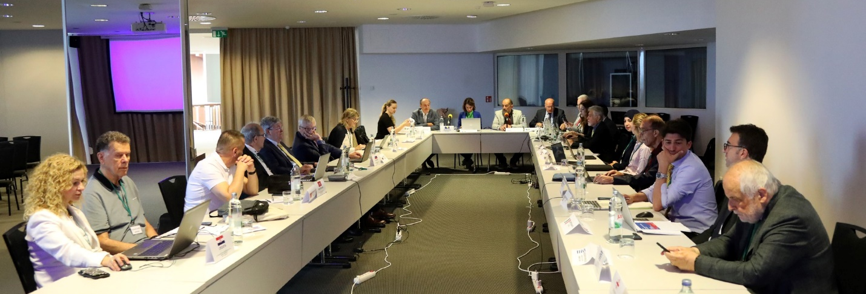
7th SEERC Workshop in Cavtat, May 28, 2024
Key Workshop Themes - Managing Spatial, Environmental, and Location Challenges in the Construction of Power Facilities: The workshop addressed national regulations on integrating power facilities into the environment, focusing on legal and spatial challenges.
Challenges and Solutions: Discussions included issues related to obtaining construction permits, electromagnetic field regulations, and architectural integration.
Future Directions: Highlighted the importance of streamlining regulatory processes and enhancing public awareness about energy infrastructure.
7th SEERC Workshop in Cavtat on May 28, 2024

Slide 10
Activities after TAC Meeting in Cavtat
Call for papers for 5th SEERC Conference launched
Conference website has been set (www.seerc2025.com)
Conference Structure:
- Opening Ceremony and Keynotes including Handing over Ceremony of SEERC chairmanship to NC Croatia
- Parallel Sessions: Conducted in three parallel tracks over two days.
- Special Panels: Including the History Panel, NGN Panel, and WIE Panel.
- Closing Session: Scheduled for June 5th at 17:30h.
The social events are planned as follows:
- Conference Dinner: Scheduled for June 4th at 19:00h at Hotel Hills.
Publication Opportunities: Selected papers will be published in the B&H Electrical Engineering journal, with awards for outstanding contributions.
Call for papers

Slide 11
Exhibition and Call for Participation
Exhibition Overview
Purpose: Showcase latest technologies, innovative products, and cutting-edge solutions in electric power systems.
Participants: Companies, research institutions, and organizations.
Why Participate?
Networking: Engage with industry leaders, researchers, policymakers, and key decision-makers.
Visibility: Gain recognition and build brand awareness in a targeted audience.
Collaboration: Foster partnerships and explore new opportunities.
Invitation to Exhibitors
Opportunity: Showcase contributions to the industry, present new technologies, and innovative solutions.
Register Now: Join us in shaping the future of the electric power industry.
Authors are strongly encouraged to submit their papers and presentations that align with the conference themes.
For more details, registration and submission go to: www.seerc2025.com

